Slide 1

Bike sharing project

Slide 2

Teammates
Ashitosh Arjun Adsule
Bharamagouda J Malashetti
Kamlesh Sanjay Patil
Kapil Pandurang Mane Deshmukh
Karthik B R
Nikhil Patil H L
Niranjan K R
Pavan Kumar M
Mentor’s
Saurabh Singh
Natarajan Senguttuvan

Slide 3

Problem statement
To build a superior model to predict the number of bicycles that can be rented with availability to data.
To predict bike count.
The variables are significant in predicting the demand for shared bikes.
To learn how real time data is represented in datasets.
To understand how to pre-process. Such data.
To study comparison of results achieved by various machine learning techniques.

Slide 4
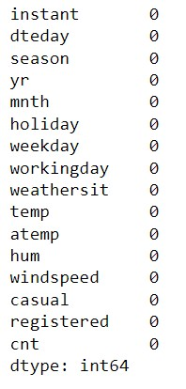
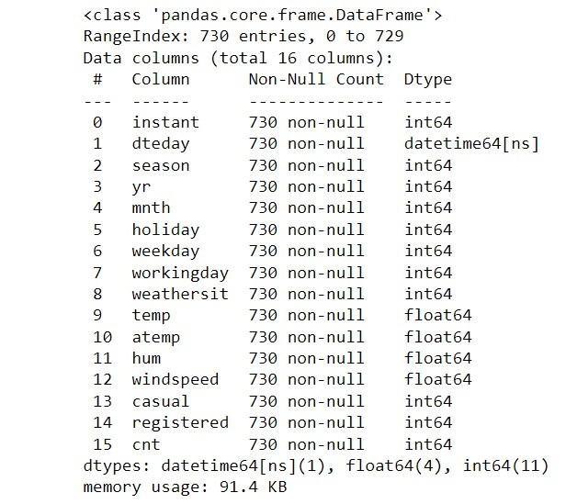
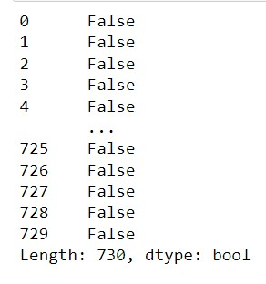
Dataset description
There is no null values in the dataset
There is no duplicate values in the dataset
Data information

Slide 5
Proposed methodology
Clean data
Remove missing data
Fetch and analyze data
Building a prediction model
Validate the model
Predict value for test data
Partition data
Create new factors
Preprocessing

Slide 6
CHALLENGES WE FACED ON THIS PROJECT
We need to remove the unwanted features in the file
Instant is likely to the index number and date is splitted into day, month and year
We checking for the casual,registered features over the cnt target variable (cnt=casual+registered)

Slide 7
Challenges we faced & methods we used to overcome
We check the Outliers in the each features over the target variable using the Barplot and Boxplot
We plot the pairplot and correlation(Heat map) on the all the numeric data
In the Heat map temp and atemp are highly correlated,so that we select the any one of them based on VIF.
We used the Training and Testing for splitting the Data and we also ueses the MinMaxScaler to scalinig
In the Model Building on Trained data using the LinearRegression
The below points are used in the Multilinearregression
Model validation
Validating the assumption of the Linear Regression Model are:
Linear Relationship
Homoscedasticity
Abesnce of Multicollinearity
Independence of residuals
Normality of Errors
We uses the Streamlit for Deploying the model

Slide 8
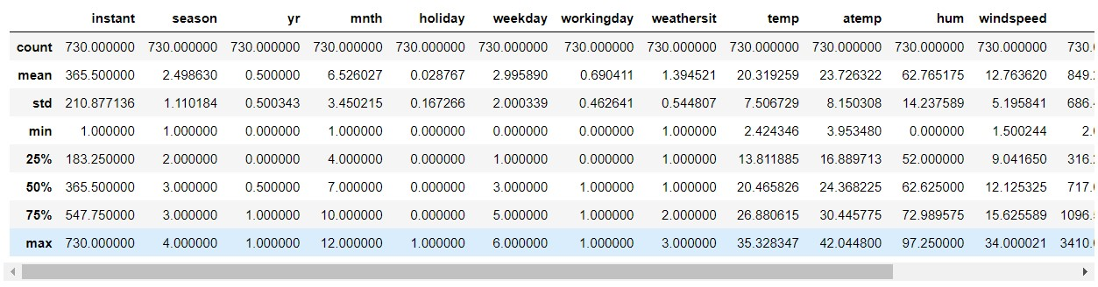
Data Describe
Observation : features in the training data are a lot different in terms of variance and mean.
There are outliers expected in “holiday” columns as the values till 50% are 0.
The instant, hum, windspeed, casual, registered columns also has a huge difference between 75% values and the max. there is a chance of getting outliers here.

Slide 9
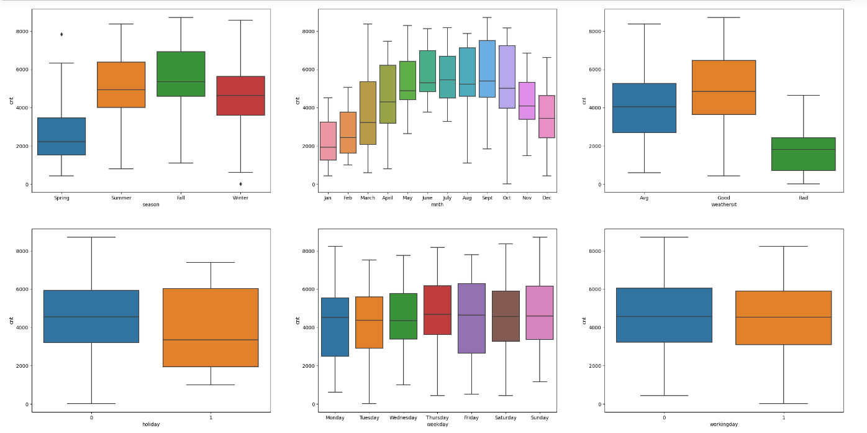
Box plot graph
Here we are finding outliers in all the features.
So we concentrate on handling the outliers.

Slide 10
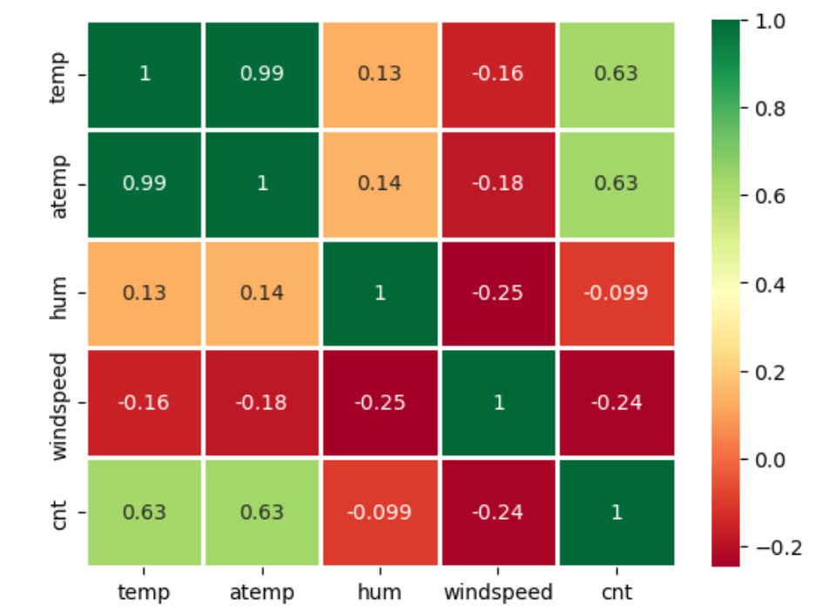
Heat map
Correlation : dependence or association is any statistical relationship, where casual or not, between two random variables or bivariate data. With the help of correlation matrix, we can find interdependency between variables
Since the correlation between Cnt and Sum is 1
So they may be eliminated from the data set.
Therefore, as can be seen from the observation above, we obtained 1 sets of columns that were highly correlated.

Slide 11
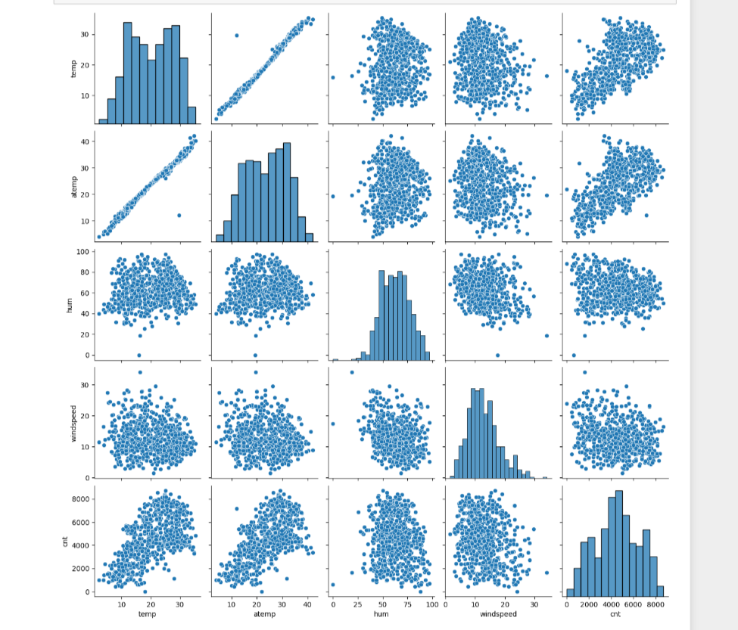
Pair Plot Graph

Slide 12
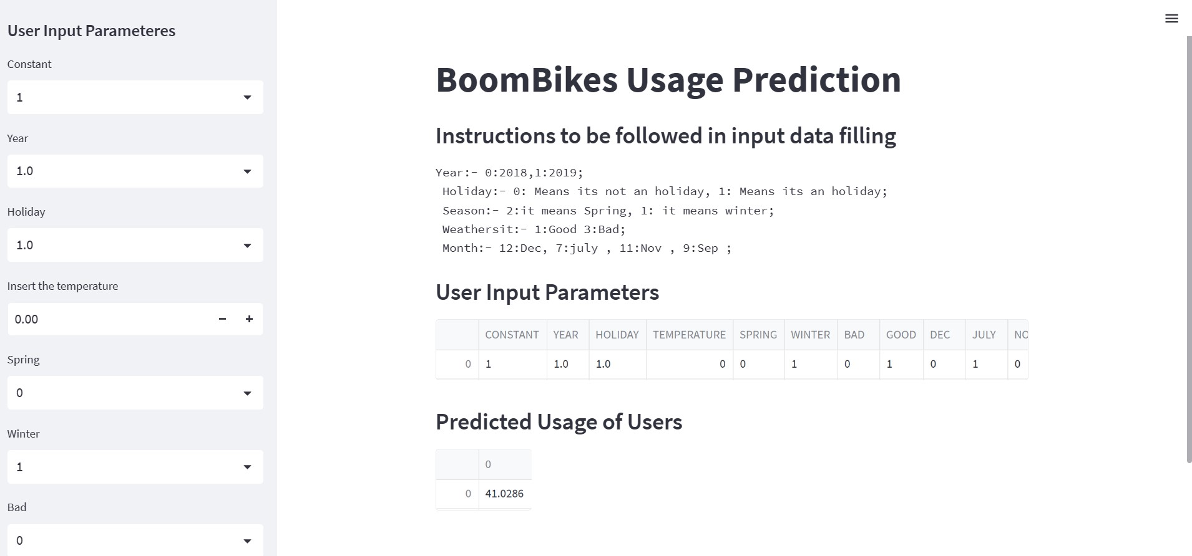
Model Deployment Using Streamlit

Slide 13


